Slide 1
UNIT-I

Slide 2
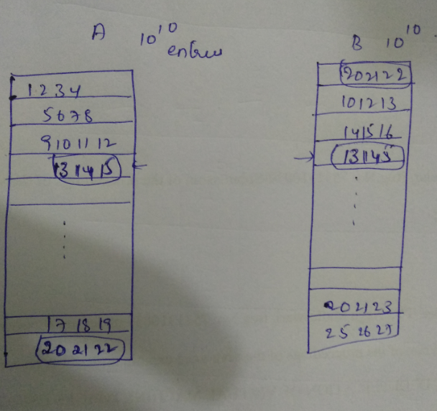
Introduction-Algorithm Design
Session Learning Outcome-SLO-To understand why algorithm design is important.
Example 1 :
Take 2 arrays A and B of 10¹⁰ entries each. Now write an algorithm to find common entries.

Slide 3
Algorithm:
Assume 2 arrays
k=1
for i=1 ton
for j=1 to n
if A[i]=B[j] then C[k] = A[i]; k=k+1
Output the array C
Steps taken by the above algorithm is n² that is (10¹⁰ ) ² = 10²⁰
How many seconds 10²⁰ steps take?
10¹⁰ Seconds = 317 years
On a modern powerful computer it takes 3 years.

Slide 4
Motivation:
Whether any way to write an algorithm for the above problem which takes less time than previously mentioned (Yes/No)
Yes
Now take example 1, finding common entries . Assume array B is arranged in increasing order ? Can I get a better algorithm. (yes / no)
Yes
If the example 2 concept (binary search) is used here. Then algorithm will be
for i=1 to n
look for A[i] in B by doing binary search and
if found store in C
Output the array C

Slide 5
Analysis:
How many steps it takes. n(log₂ n)
n= 10¹⁰
n(log₂ n) = 10¹⁰ (log₂ 10¹⁰ )
10¹⁰steps in 1 second then it for the above steps, it takes 10¹⁰ (log₂ 10¹⁰ ) / 10¹⁰ <=40 secs

Slide 6
Example 2
A book contains page number from 1 and 1024, and I have to search 73 page
Maximum number of comparisons is
512, 256, 128, 64, 32, 16, 8, 4, 2, 1.
If Binary search is applied
For the range 1-1024 –10 comparisons
For the range 1-2048 – 11 comparisons
For the range 1-4096- 12 comparisons
For the range 1-N--- ? Comparisons
It is log N comparisons ( 1024= 2 ¹⁰ ), 2048= 2 ¹¹ 4096 = 2 ¹² …….
log₂ N is the number of powers of 2 in N
log₂ N is a slow growing function
What is the relation

Slide 7
Summary:
More than the power of computers, an improvement in algorithm can make a difference between 317 years and 40 seconds.
How much time to take for sorting?
Can I choose O(n²) ?
Quick sort, Mergesort…

Slide 8
Fundamentals of Algorithms
Session Learning Outcome-SLO:
Able to know what is an algorithm and how to write algorithm / pseudocode.
What is an algorithm?
It is a finite set of instructions or a sequence of computational steps that if followed it accomplishes a task.
Characteristics of an algorithm:
Input : 0 or more input
Output: 1 or more output
Definiteness: clear and unambiguous
Finiteness: termination after finite number of steps
Effectiveness: solved by pen and paper

Slide 9
Describing the Algorithm
The skills required to effectively design and analyze algorithms are entangled with the skills required to effectively describe algorithms. A complete description of any algorithm has four components:
What: A precise specification of the problem that the algorithm solves.
How: A precise description of the algorithm itself.
Why: A proof that the algorithm solves the problem it is supposed to solve.
How fast: An analysis of the running time of the algorithm.
It is not necessary (or even advisable) to develop these four components in this particular order. Problem specifications, algorithm descriptions, correctness proofs, and time analyses usually evolve simultaneously, with the development of each component informing the development of the others.

Slide 10
Specification/ Design of Algorithm
The algorithm can be specified either using:
Natural language
Pseudo code
Flow chart

Slide 11
Natural Language
Step 1: Start
Step 2: Declare variables num1, num2 and sum.
Step 3: Read values num1 and num2.
Step 4: Add num1 and num2 and assign the result to sum. sum←num1+num2
Step 5: Display sum
Step 6: Stop

Slide 12
Pseudo code
BEGIN.
NUMBER s1, s2, sum.
OUTPUT("Input number1:")
INPUT s1.
OUTPUT("Input number2:")
INPUT s2.
sum=s1+s2.
OUTPUT sum.

Slide 13
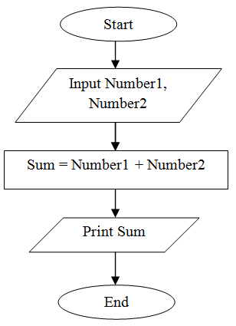
Flowchart

Slide 14
Specifying the Problem
To describe an algorithm, the problem is described that the algorithm is supposed to solve.
Algorithmic problems are often presented using standard English, in terms of real-world objects. The algorithm designers, restate these problems in terms of formal, abstract, mathematical objects—numbers, arrays, lists, graphs, trees, and so on
If the problem statement carries any hidden assumptions, state those assumptions explicitly;
Specification to be refined as we develop the algorithm. For example, an algorithm may require a particular input representation, or produce a particular output representation, that was left unspecified in the original informal problem description.

Slide 15
The specification should include just enough detail that someone else could use our algorithm as a black box, without knowing how or why the algorithm actually works.
In particular, the type and meaning of each input parameter, and exactly how the eventual output depends on the input parameters are described. On the other hand, specification should deliberately hide any details that are not necessary to use the algorithm as a black box.
Example: Given two non-negative integers x and y, each represented as an array of digits, compute the product x · y, also represented as an array of digits. To someone using these algorithms, the choice of algorithm is completely irrelevant.

Slide 16
Describing Algorithms
The clearest way to present an algorithm is using a combination of pseudocode and structured English.
Pseudocode uses the structure of formal programming languages and mathematics to break algorithms into primitive steps; the primitive steps themselves can be written using mathematical notation, pure English, or an appropriate mixture of the two, whatever is clearest.
Well written pseudocode reveals the internal structure of the algorithm but hides irrelevant implementation details, making the algorithm easier to understand, analyze, debug, and implement.

Slide 17
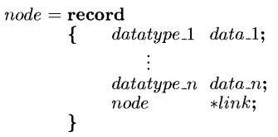
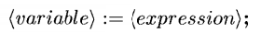
Pseudocode conventions
Comments //
Blocks {and }.
An identifier begins with a letter
; (dot), -> operator
Assignment---
Two Boolean values true and false, logical operators and, or, and not, relational operators <, ≤, ≥,and >

Slide 18
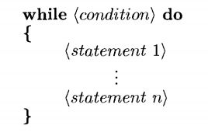
Elements of multi-dimensional arrays are accessed using[ and ]. For example, if A is a two dimensional array, the (i,j)th element of the array is denoted as - A[i, j]. Array indices start at zero.
Looping statements- for, while and repeat-until
while loop written as
As long as (condition)is true, the statements get executed. When (condition)becomes false, the loop is exited. The value of (condition) is evaluated at the top of the loop.

Slide 19
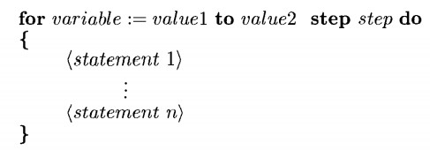
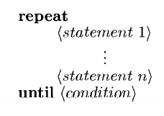
The general form of a for loop is
Here valuel, value2, and step are arithmetic expression The clause "step step" is optional and taken as +1 if it does not occur. Step could either be positive or negative
A repeat-until statement is constructed as follows:

Slide 20
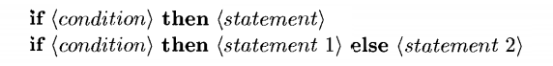
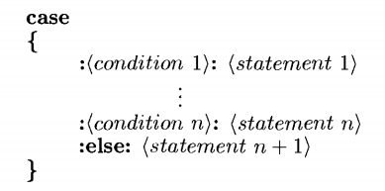
break –
return
Conditional statement has the following forms
Multiple-decision statement as:
Input, output : read, write

Slide 21
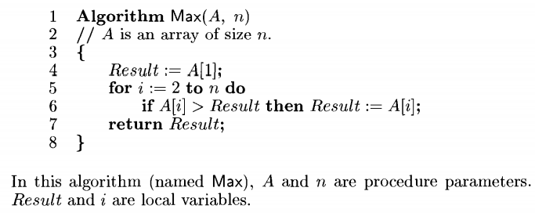
Procedure: Algorithm. An algorithm consists of a heading and a body.
Where Name is procedure name and (<parameter list>) is a listing of the procedure parameters. The body has one or more (simple or compound)statements enclosed within braces {and } .
Example of pseudocode:

Slide 22
Analysing Algorithms:
We have to prove that the algorithm actually does what it’s supposed to do, and that it does so efficiently.
Correctness
In some application settings, it is acceptable for programs to behave correctly most of the time, on all “reasonable” inputs.
But we require algorithms that are always correct, for all possible inputs.
We must prove that our algorithms are correct; trusting our instincts, or trying a few test cases, isn’t good enough.
In particular, correctness proofs usually involve induction.

Slide 23
Analyzing Algorithms:
Running Time
The most common way of ranking different algorithms for the same problem is by how quickly they run. Ideally, we want the fastest possible algorithm for any particular problem.

Slide 24
Summary:
Every problem is to be specified, for which an algorithm is described in the form of pseudocode and is analysed to test its efficiency.
Home assignment:
Write the pseudocode for finding matrix multiplication of 2 two-dimensional arrays.
Write the pseudocode for linear search.

Slide 25
Correctness of Algorithm
Session Learning Outcome-SLO:
Able to prove the correctness of an algorithm by any of the methods.
A proof of correctness requires that the solution be stated in two forms.
One form is usually as a program which is annotated by a set of assertions about the input and output variables of the program. These assertions are often expressed in the predicate calculus.
The second form is called a specification, and this may also be expressed in the predicate calculus.
A proof consists of showing that these two forms are equivalent in that for every given legal input, they describe the same output. A complete proof of program correctness requires that each statement of the programming language be precisely defined and all basic operations be proved correct.
A proof of correctness is much more valuable than a thousand tests(if that proof is correct),since it guarantees that the program will work correctly for all possible inputs.

Slide 26
Methods of proving correctness
How to prove that an algorithm is correct?
Proof by:
Counterexample (indirect proof )
Induction (direct proof )
Loop Invariant
Other approaches:
proof by cases/enumeration
proof by chain of iffs
proof by contradiction
proof by contrapositive
For any algorithm, we must prove that it always returns the desired output for all legal instances of the problem. For sorting, this means even if the input is already sorted or it contains repeated elements.

Slide 27
Assertions
To prove correctness we associate a number of assertions (statements about the state of the execution) with specific checkpoints in the algorithm.
E.g., A[1], …, A[k] form an increasing sequence
Preconditions – assertions that must be valid before the execution of an algorithm or a subroutine
Postconditions – assertions that must be valid after the execution of an algorithm or a subroutine

Slide 28
Loop Invariants
Invariants – assertions that are valid any time they are reached (many times during the execution of an algorithm, e.g., in loops)
We must show three things about loop invariants:
Initialization – it is true prior to the first iteration
Maintenance – if it is true before an iteration, it remains true before the next iteration
Termination – when loop terminates the invariant gives a useful property to show the correctness of the algorithm

Slide 29
Proof by mathematical induction
Mathematical induction (MI) is an essential tool for proving the statement that proves an algorithm's correctness. The general idea of MI is to prove that a statement is true for every natural number n.
It contains 3 steps:
Induction Hypothesis: Define the rule we want to prove for every n, let's call the rule f(n).
Induction Base: Proving the rule is valid for an initial value, or rather a starting point - this is often proven by solving the Induction Hypothesis f(n) for n=1 or whatever initial value is appropriate
Induction Step: Proving that if we know that f(n) is true, we can step one step forward and assume f(n+1) is correct

Slide 30
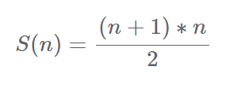
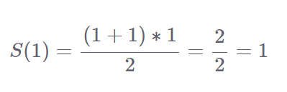
Example
If we define S(n) as the sum of the first n natural numbers, for example S(3) = 3+2+1, prove that the following formula can be applied to any n:
Let's trace our steps:
Induction Hypothesis: S(n) defined with the formula above
Induction Base: In this step we have to prove that S(1) = 1

Slide 31
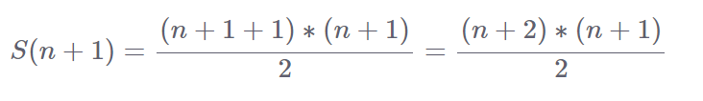
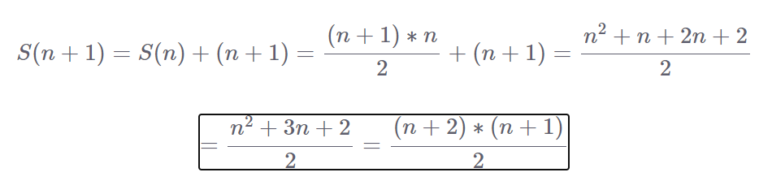
Induction Step: In this step we need to prove that if the formula applies to S(n), it also applies to S(n+1) as follows:
This is known as an implication (a=>b), which just means that we have to prove b is correct providing we know a is correct.
Note that S(n+1) = S(n) + (n+1) just means we are recursively calculating the sum.
Example with literals:
S(3) = S(2) + 3= S(1) + 2 + 3 = 1 + 2 + 3 = 6 Hence proved

Slide 32
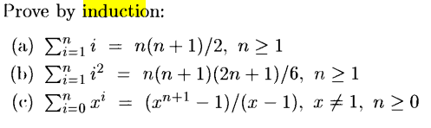
Home Assignment
Summary:
For every algorithm proof of correctness is very important to show that the program is correct in all cases.

Slide 33
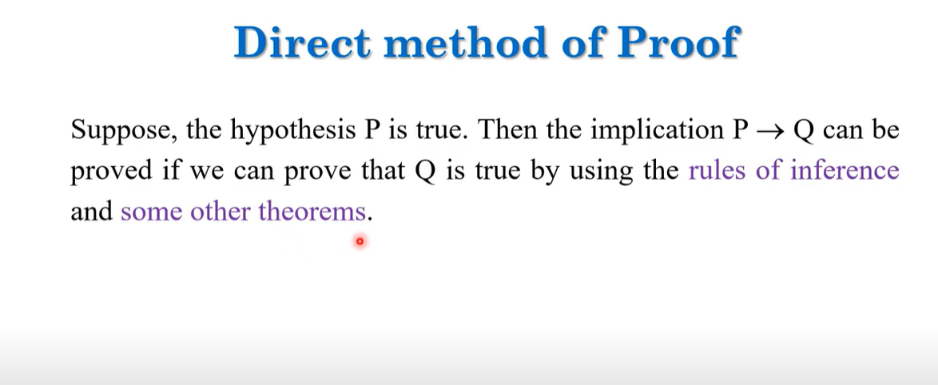
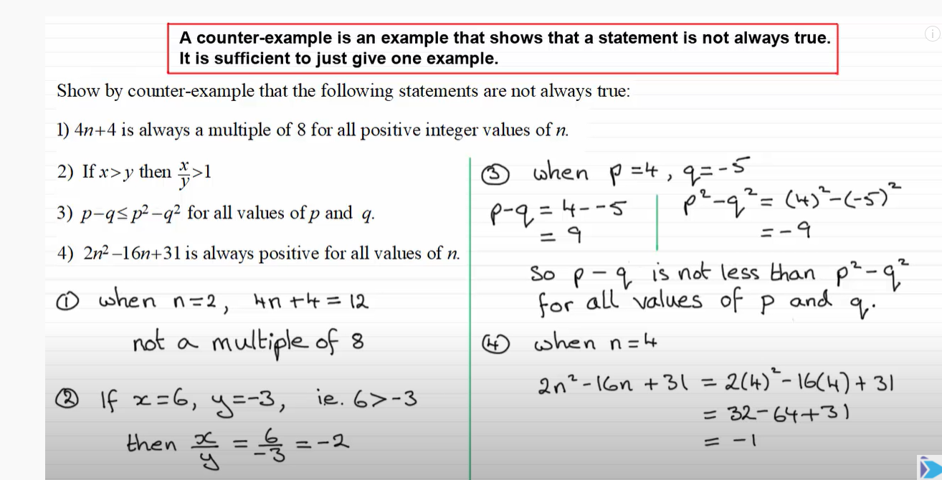

Slide 34
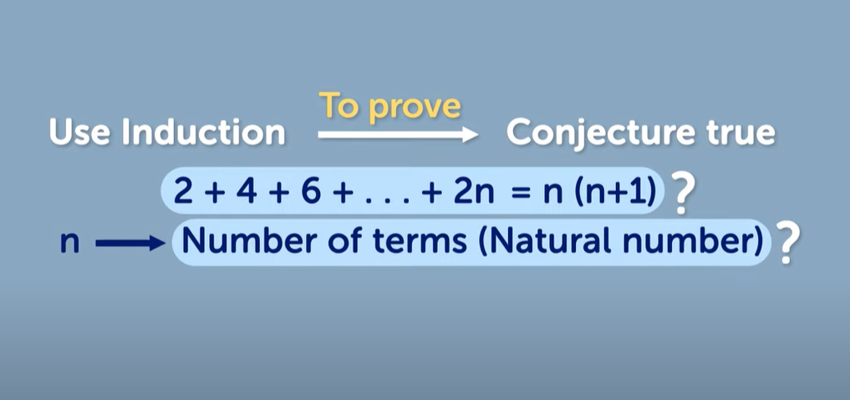
Conjecture : inferring

Slide 35
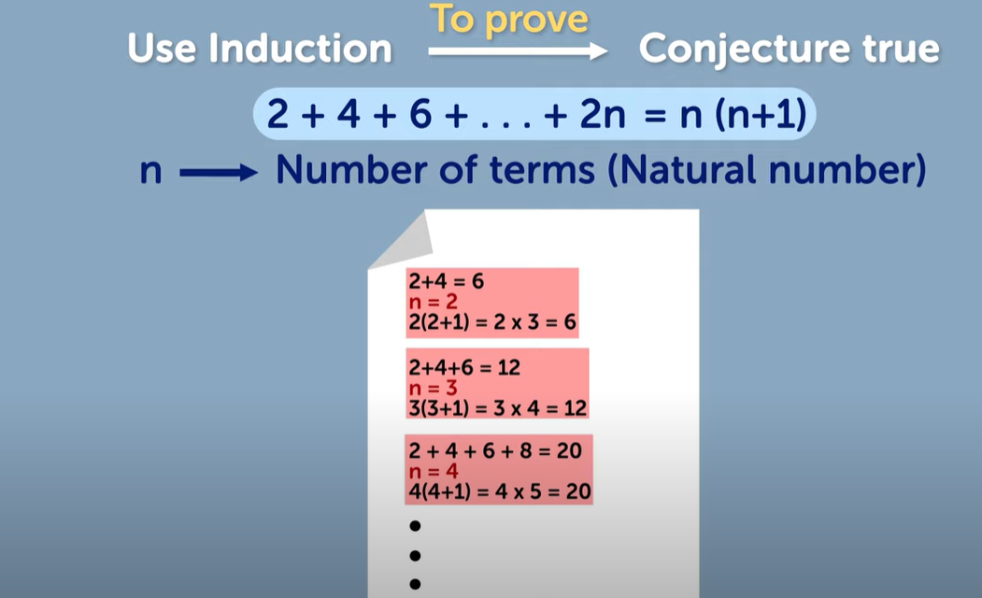

Slide 36
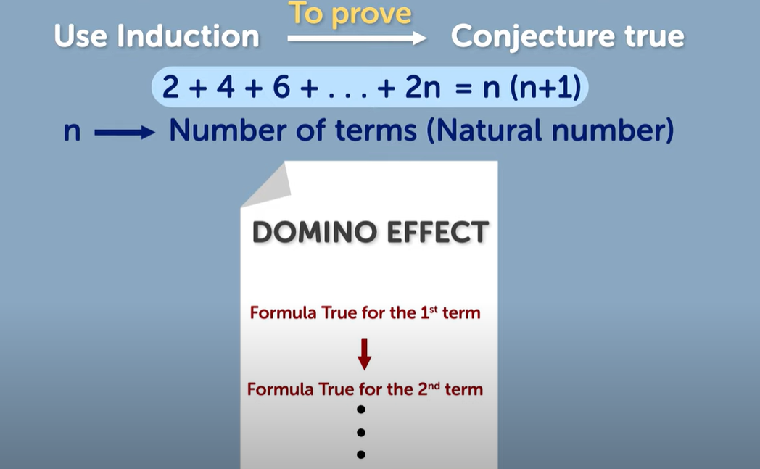

Slide 37
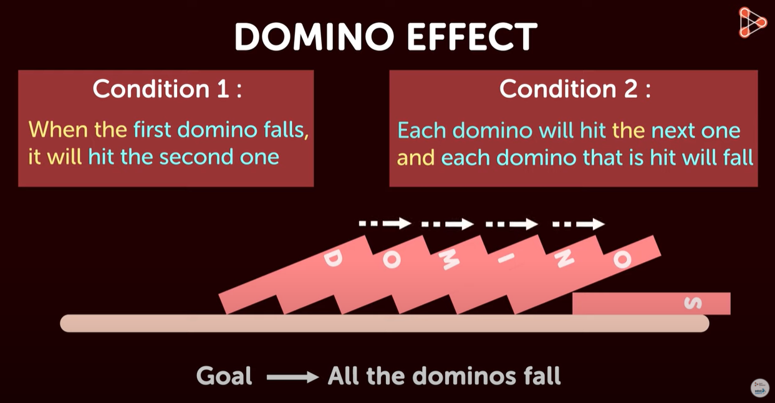

Slide 38
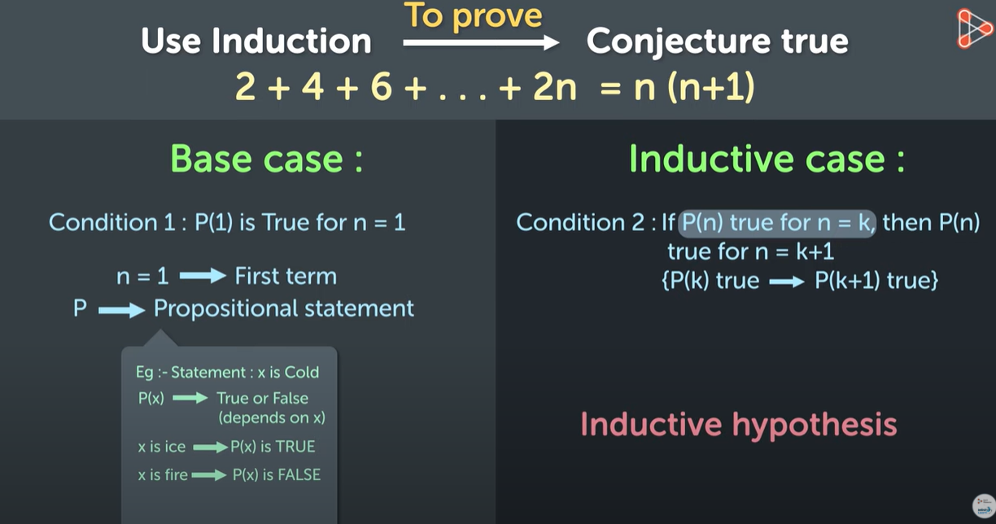

Slide 39
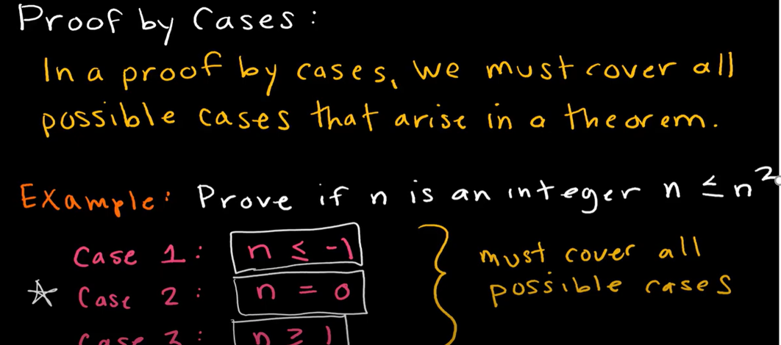
Proof by Case method

Slide 40
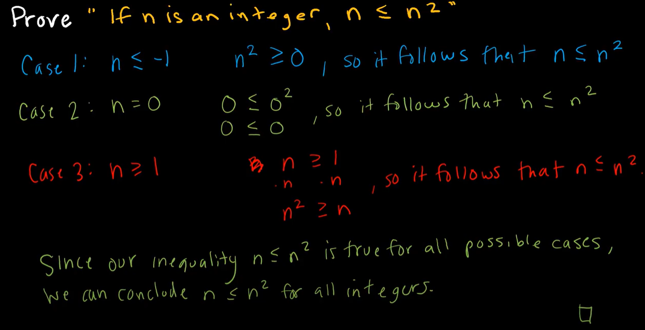

Slide 41
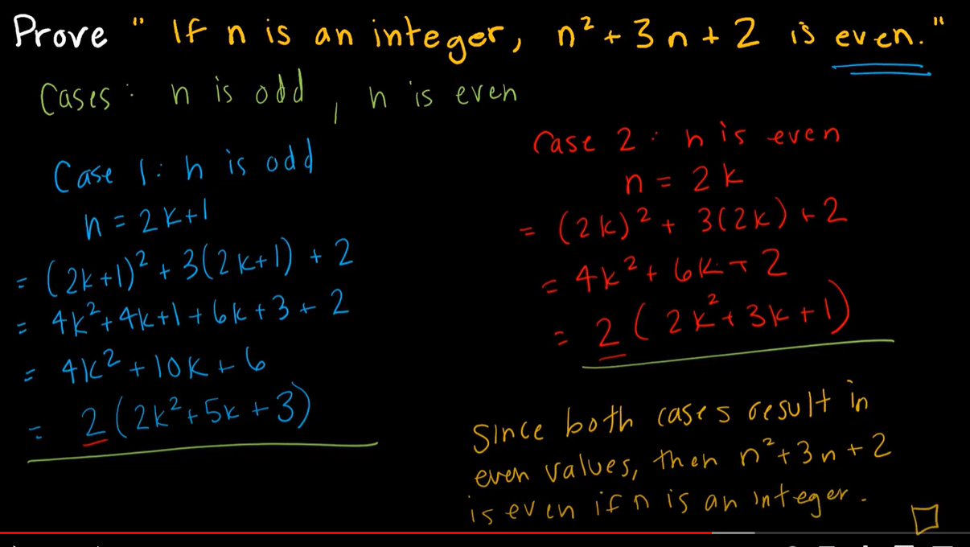

Slide 42
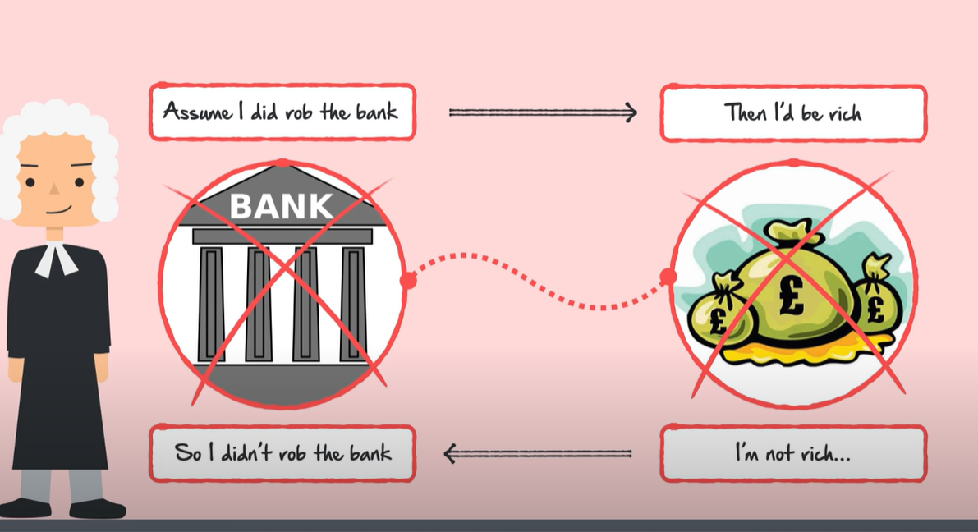
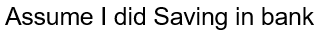
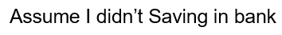
Proof by chain of IFFs?
Assume I didn’t Saving in bank

Slide 43

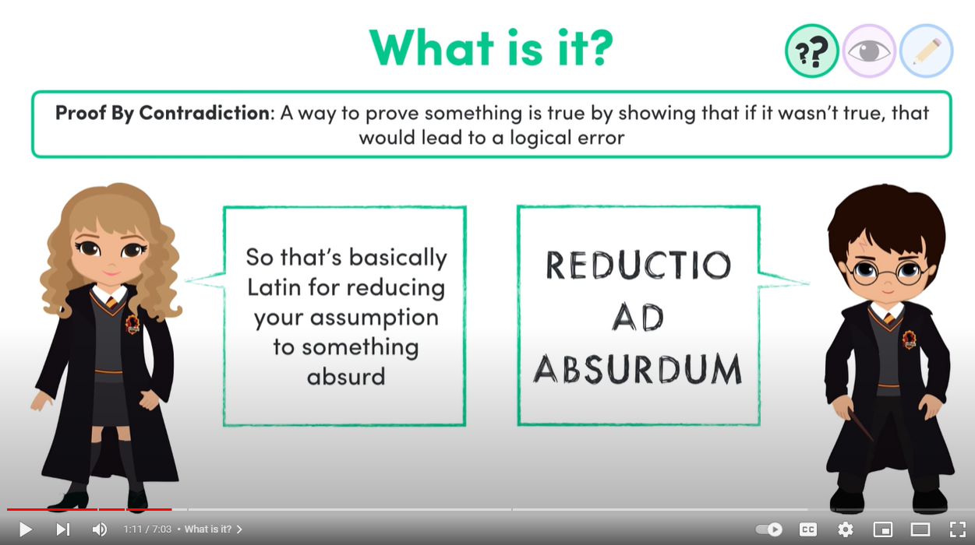
not at all logical

Slide 44
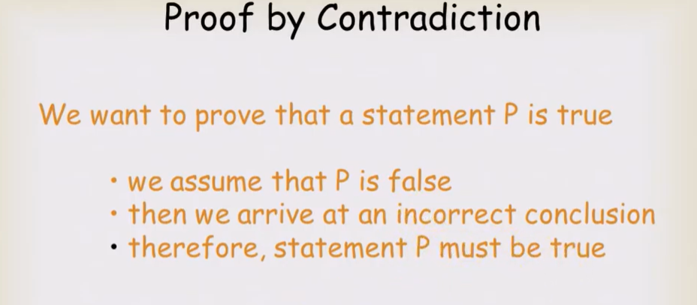

Slide 45
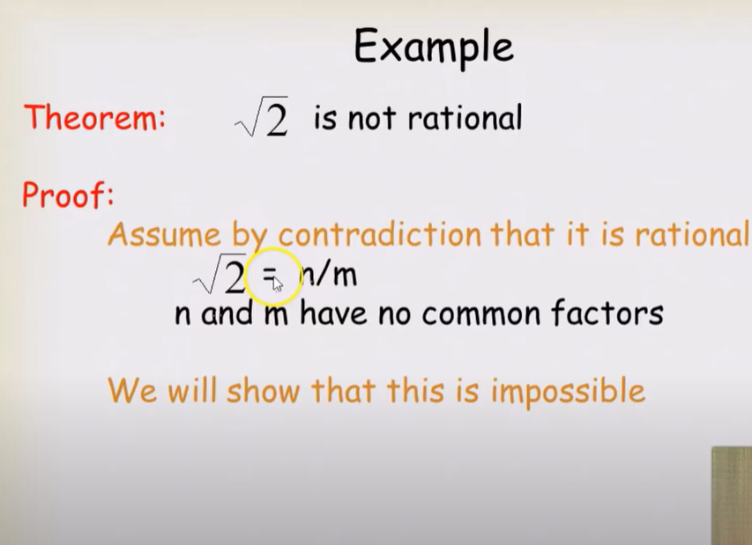

Slide 46
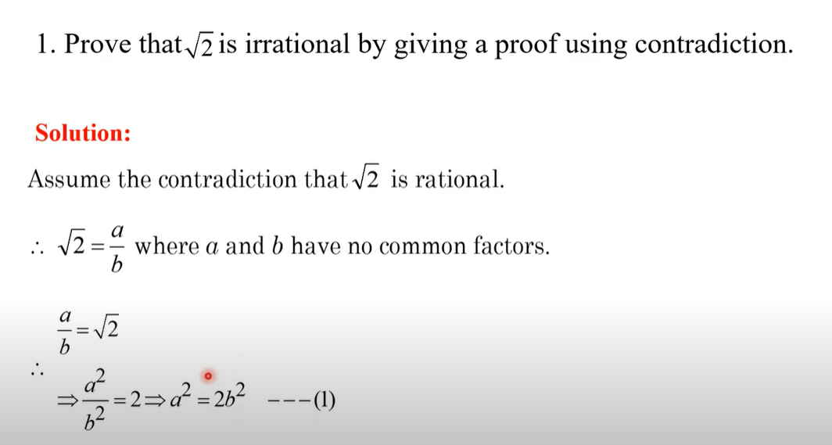

Slide 47
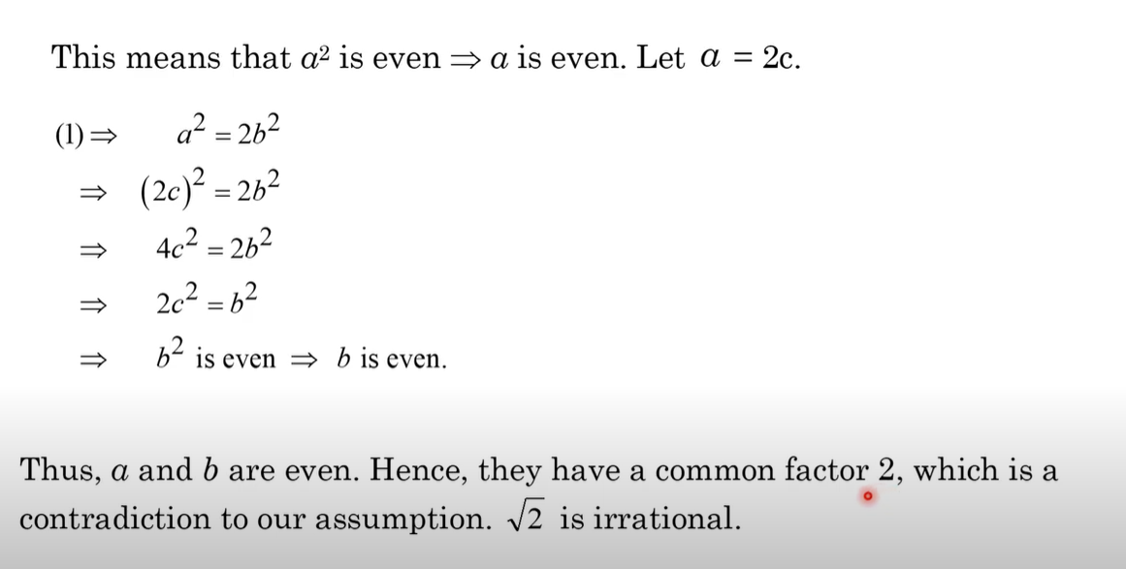

Slide 48
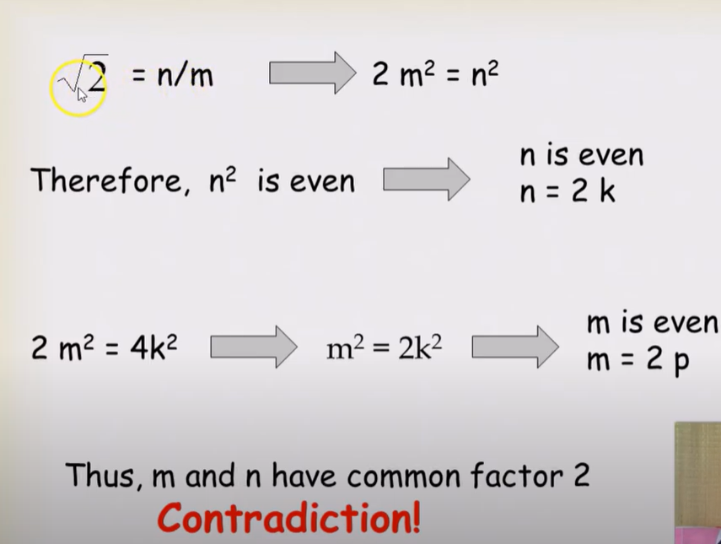

Slide 49
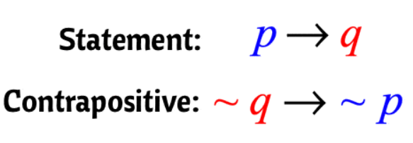
Contrapositive

Slide 50
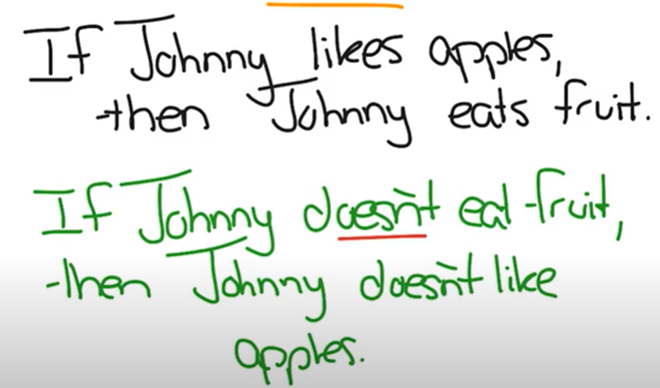

Slide 51
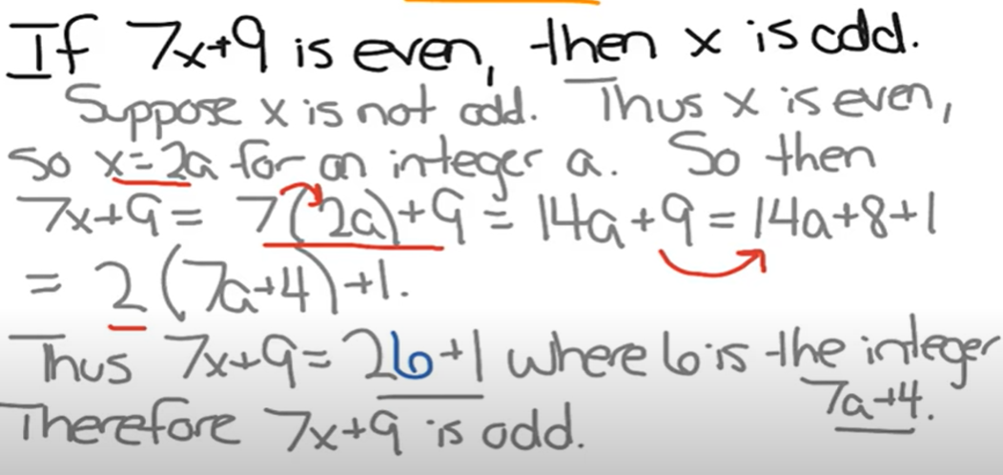

Slide 52
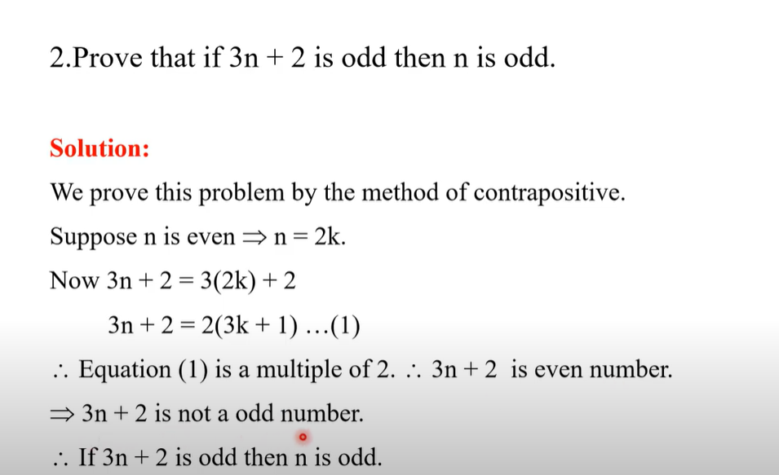

Slide 53
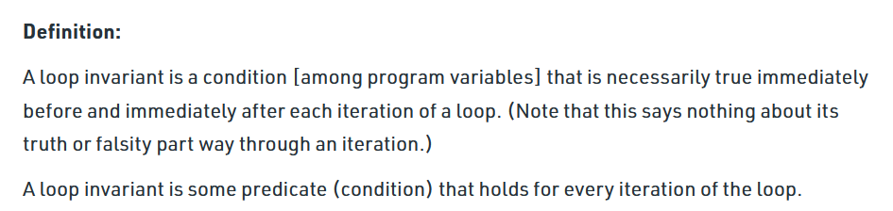
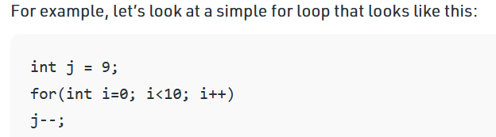
Loop Invariant

Slide 54
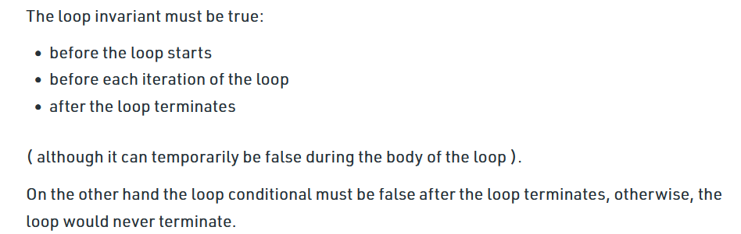
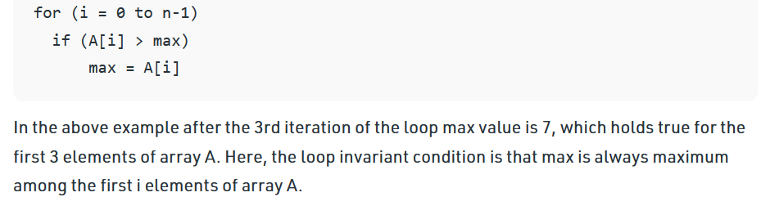

Slide 55

Performance Analysis
Time Complexity
Space Complexity
Communication Bandwidth

Slide 56

Space Complexity Analysis
The space complexity of an algorithm is the amount of memory it needs to run to completion.

Slide 57
Space Complexity S(P)=C+S_{P}(I)
Fixed Space Requirements (C) Independent of the characteristics of the inputs and outputs
instruction space
space for simple variables, fixed-size structured variable, constants
Variable Space Requirements (S_{P}(I)) depend on the instance characteristic I
number, size, values of inputs and outputs associated with I
recursive stack space, formal parameters, local variables, return address

Slide 58
Example
#include<stdio.h>
int main()
{
int a = 5, b = 5, c;
c = a + b;
printf("%d", c);
}
Space Complexity: size(a)+size(b)+size(c)
=>let sizeof(int)=2 bytes=>2+2+2=6 bytes
=>O(1) or constant

Slide 59
Example
#include <stdio.h>
int main()
{
int n, i, sum = 0;
scanf("%d", &n);
int arr[n];
for(i = 0; i < n; i++)
{
scanf("%d", &arr[i]); sum = sum + arr[i];
}
printf("%d", sum);
}
Space Complexity:
The array consists of n integer elements.
So, the space occupied by the array is 4 * n. Also we have integer variables such as n, i and sum. Assuming 4 bytes for each variable, the total space occupied by the program is 4n + 12 bytes.
Since the highest order of n in the equation 4n + 12 is n, so the space complexity is O(n) or linear.

Slide 60
Time complexity analysis
Session Learning Outcome-SLO:
Able to write algorithms and analyze its complexity
The time T(P) taken by a program P is
T(P) =compile time + run (or execution) time.
The compile time does not depend on the instance characteristics.
Also, the compiled program will be run several times without recompilation. Consequently, the run time of a program only considered. This run time is denoted by t_{p} (instance characteristics)
As the factors that influence t_{p} , when the program run it is better to estimate t_{p}
If the compiler characteristics and the time taken for addition, subtraction, division, multiplication etc.. are known then we can find t_{p} as

Slide 61
Where n denotes the instance characteristics, and c_{a},c_{s},c_{m}, c_{d}, and so on, respectively, denote the time needed for an addition, subtraction, multiplication, division, and so on.
ADD, SUB,MUL,DIV, and so on, are functions whose values are the numbers of additions, subtractions, multiplications, divisions, and so on, that are performed when the code for P is used on an instance with characteristic n.
It is difficult to get such an exact formula because the time taken for addition and other operations depends on numbers that are being added.
So alternative is to do all activities such as program typing, compiling and running on a machine and the execution time is physically clocked to get t_{p}(n).
Drawbacks of experimental approach is the execution time depends on the other programs running on the computer at the time the program P run. It also depends on machine architecture.

Slide 62
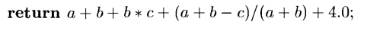
Solution:
Obtain a count for the total number of operations in the algorithm. We can go one step further and count only the number of program steps.
A program step is loosely defined as a syntactically or semantically meaningful segment of a program that has an execution time that is independent of the instance characteristics. For example, the entire statement is a single program step.
The number of steps any program statement is assigned depends on the kind of statement.
Comments count as zero steps;
an assignment statement which does not involve any calls to other algorithms is counted as one step;
In an iterative statement such as the for, while, and repeat-until statements, we consider the step counts only for the control part of the statement.

Slide 63
Two methods to find the time complexity for an algorithm
Count variable method
Table method

Slide 64
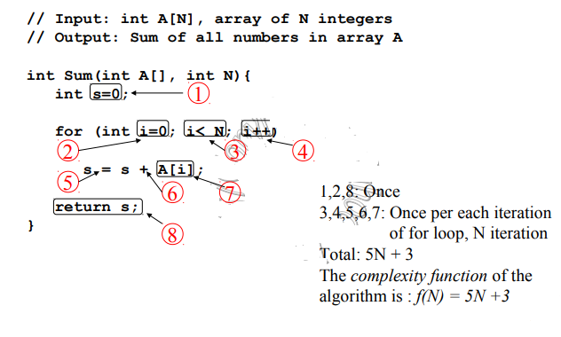
Using Count Method

Slide 65
Table method
The table contains s/e and frequency.
The s/e of a statement is the amount by which the count changes as a result of the execution of that statement.
Frequency is defined as the total number of times each statement is executed.
Combining these two, the step count for the entire algorithm is obtained.

Slide 66
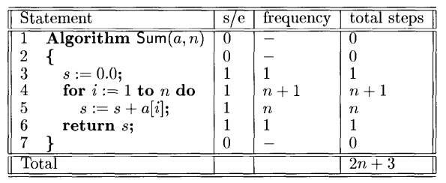
Example 1

Slide 67
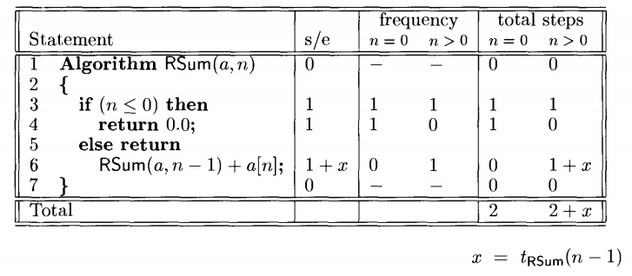
Example 2

Slide 68
Class Activity- Find Time Complexity
1. for (let i = 0; i < n; ++i)
{ console.log(i); }
O(n) ----------- Linear Time Complexity
2. for (let i = 0; i < n; ++i)
{ for (let j = 0; j < n; ++j)
{ console.log(i, j);
}
} O(n² ) --------- Exponential Time Complexity
3. for (let i = 1; i < n; i *= 2)
{ console.log(i); }
O(log2n) ----------Logarithmic Time Complexity

Slide 69
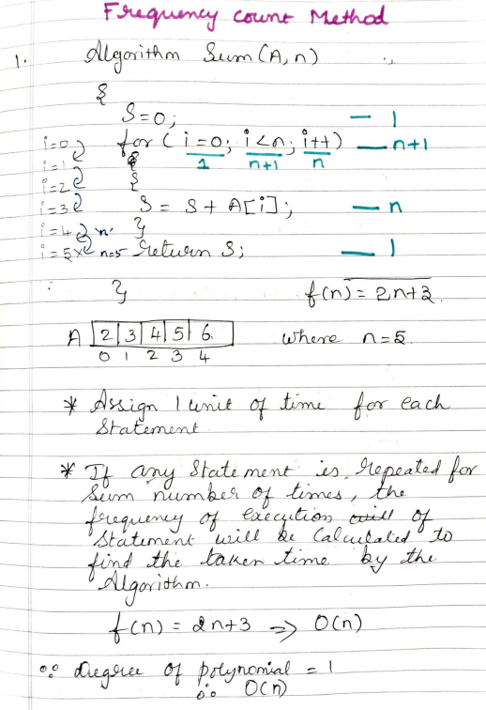
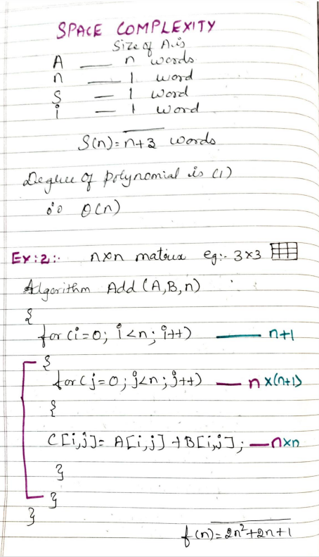

Slide 70
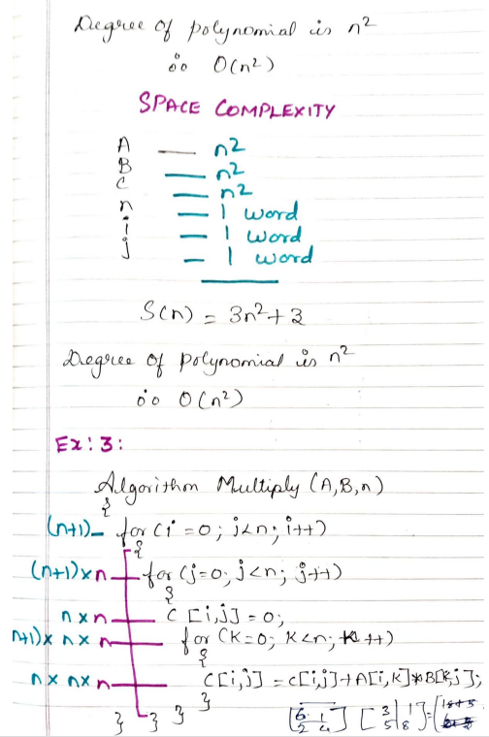
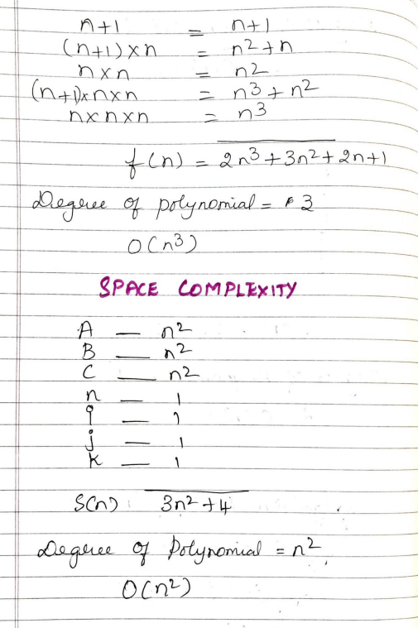

Slide 71



Slide 72


Slide 73




Slide 74


Slide 75


Slide 76



Slide 77



Slide 78


Slide 79


Slide 80


Slide 81


Slide 82


Slide 83

Home assignment
Calculate the time complexity for the below algorithms using table method
1.

Slide 84


2.
3.

Slide 85
Insertion Sort

Slide 86
INTRODUCTION
Session Learning Outcome - SLO – To Understand the concept of Insertion sort, the time complexity of an algorithm and Algorithm design paradigms.

Slide 87
ALGORITHM DESIGN AND ANALYSIS
Efficiency of the algorithm’s design is totally dependent on the understanding of the problem.
The important parameters to be considered in understanding the problem are:
Input
Output
Order of Instructions
Check for repetition of Instructions
Check for the decisions based on conditions

Slide 88

INSERTION SORT
Insertion Sort Algorithm sorts array by shifting elements one by one and inserting the right element at the right position
It works similar to the way you sort playing cards in your hands

Slide 89
PROCEDURE
We start by making the second element of the given array, i.e. element at index 1, the key.
We compare the key element with the element(s) before it, i.e., element at index 0:
If the key element is less than the first element, we insert the key element before the first element.
If the key element is greater than the first element, then we insert it after the first element.
Then, we make the third element of the array as key and will compare it with elements to it's left and insert it at the right position.
And we go on repeating this, until the array is sorted.

Slide 90
EXAMPLE
Step 1:
Step 2: (A[1] is compared with A[0], Since 2<7, its swapped)
Step 3: (A[2] is compared with A[1] and A[0]. As 8 is the largest of all 3, no swapping is done)
7 | 2 | 8 | 1 | 5 | 3
2 | 7 | 8 | 1 | 5 | 3
2 | 7 | 8 | 1 | 5 | 3

Slide 91
EXAMPLE (Contd..)
Step 4: (A[3] is compared with A[2], A[1] and A[0]. Since 1 is the smallest of all, its is swapped)
Step 5: (A[4] is compared with A[3], A[2], A[1] and A[0]. Since 5 is lesser than 8 and 7 and greater than 2, it is swapped and placed between 2 and 7)
1 | 2 | 7 | 8 | 5 | 3
1 | 2 | 5 | 7 | 8 | 3

Slide 92
EXAMPLE (Contd..)
Step 6: (A[5] is compared with A[4], A[3], A[2], A[1] and A[0]. Since 3 is lesser than 8,7,5 and greater than 1 &2, it is placed between 2 and 5).
Array is sorted.
1 | 2 | 3 | 5 | 7 | 8

Slide 93


Slide 94

Insertion Sort
Example :
9 | 2 | 7 | 5 | 1 | 4 | 3 | 6

Slide 95
Insertion Sort
Sorte d sectio n
9 | 2 | 7 | 5 | 1 | 4 | 3 | 6
We start by dividing the array in a sorted section and an unsorted section. We put the first element as the only element in the sorted section, and the rest of the array is the unsorted section.

Slide 96
Insertion Sort
Sorte d
Item to positi on
sectio n
9 | 2 | 7 | 5 | 1 | 4 | 3 | 6
The first element in the unsorted section is the next element to be put into the correct position.

Slide 97
Insertion Sort
Item to positi on
9 | 2 | 7 | 5 | 1 | 4 | 3 | 6
2
We copy the element to be placed into another variable so it doesn’t get overwritten.

Slide 98
Insertion Sort
9 | 2 | 7 | 5 | 1 | 4 | 3 | 6
2
compare
If the previous position is more than the item being placed, copy
the value into the next position

Slide 99
Insertion Sort
belongs here
9 | 9 | 7 | 5 | 1 | 4 | 3 | 6
2
If there are no more items in the sorted section to compare with, the
item to be placed must go at the front.

Slide 100
Insertion Sort
2 | 9 | 7 | 5 | 1 | 4 | 3 | 6

Slide 101
Insertion Sort
2 | 9 | 7 | 5 | 1 | 4 | 3 | 6

Slide 102
Insertion Sort
Item to positi on
2 | 9 | 7 | 5 | 1 | 4 | 3 | 6

Slide 103
Insertion Sort
2 | 9 | 7 | 5 | 1 | 4 | 3 | 6
7
compare

Slide 104
Insertion Sort
Copied from previous position
belongs here
2 | 9 | 9 | 5 | 1 | 4 | 3 | 6
7
compare
If the item in the sorted section is less than the item to place, the item to place goes after it in the array.

Slide 105
Insertion Sort
2 | 7 | 9 | 5 | 1 | 4 | 3 | 6

Slide 106
Insertion Sort
2 | 7 | 9 | 5 | 1 | 4 | 3 | 6

Slide 107
Insertion Sort
Item to positi on
2 | 7 | 9 | 5 | 1 | 4 | 3 | 6

Slide 108
Insertion Sort
2 | 7 | 9 | 5 | 1 | 4 | 3 | 6
5
compare

Slide 109
Insertion Sort
2 | 7 | 9 | 9 | 1 | 4 | 3 | 6
5
compare

Slide 110
Insertion Sort
belongs here
2 | 7 | 7 | 9 | 1 | 4 | 3 | 6
5
compare

Slide 111
Insertion Sort
2 | 5 | 7 | 9 | 1 | 4 | 3 | 6

Slide 112
Insertion Sort
2 | 5 | 7 | 9 | 1 | 4 | 3 | 6

Slide 113
Insertion Sort
Item to positi on
2 | 5 | 7 | 9 | 1 | 4 | 3 | 6

Slide 114
Insertion Sort
2 | 5 | 7 | 9 | 1 | 4 | 3 | 6
1
compare

Slide 115
Insertion Sort
2 | 5 | 7 | 9 | 9 | 4 | 3 | 6
1
compare

Slide 116
Insertion Sort
2 | 5 | 7 | 7 | 9 | 4 | 3 | 6
1
compare

Slide 117
Insertion Sort
2 | 5 | 5 | 7 | 9 | 4 | 3 | 6
1
compare

Slide 118
Insertion Sort
belongs here
2 | 2 | 5 | 7 | 9 | 4 | 3 | 6
1

Slide 119
Insertion Sort
1 | 2 | 5 | 7 | 9 | 4 | 3 | 6

Slide 120
Insertion Sort
1 | 2 | 5 | 7 | 9 | 4 | 3 | 6

Slide 121
Insertion Sort
Item to positi on
1 | 2 | 5 | 7 | 9 | 4 | 3 | 6

Slide 122
Insertion Sort
1 | 2 | 5 | 7 | 9 | 4 | 3 | 6
4
e
compar

Slide 123
Insertion Sort
1 | 2 | 5 | 7 | 9 | 9 | 3 | 6
4
compare

Slide 124
Insertion Sort
1 | 2 | 5 | 7 | 7 | 9 | 3 | 6
4
compare

Slide 125
Insertion Sort
belongs here
1 | 2 | 5 | 5 | 7 | 9 | 3 | 6
4
compare

Slide 126
Insertion Sort
1 | 2 | 4 | 5 | 7 | 9 | 3 | 6

Slide 127
Insertion Sort
1 | 2 | 4 | 5 | 7 | 9 | 3 | 6

Slide 128
Insertion Sort
Item to positi on
1 | 2 | 4 | 5 | 7 | 9 | 3 | 6

Slide 129
Insertion Sort
1 | 2 | 4 | 5 | 7 | 9 | 3 | 6
3
compare

Slide 130
Insertion Sort
1 | 2 | 4 | 5 | 7 | 9 | 9 | 6
3
compare

Slide 131
Insertion Sort
1 | 2 | 4 | 5 | 7 | 7 | 9 | 6
3
compare

Slide 132
Insertion Sort
1 | 2 | 4 | 5 | 5 | 7 | 9 | 6
3
compare

Slide 133

Insertion Sort
belongs here
1 | 2 | 4 | 4 | 5 | 7 | 9 | 6
3
compare

Slide 134
Insertion Sort
1 | 2 | 3 | 4 | 5 | 7 | 9 | 6

Slide 135
Insertion Sort
1 | 2 | 3 | 4 | 5 | 7 | 9 | 6

Slide 136
Insertion Sort
Item to positi on
1 | 2 | 3 | 4 | 5 | 7 | 9 | 6

Slide 137
Insertion Sort
1 | 2 | 3 | 4 | 5 | 7 | 9 | 6
6
e
compar

Slide 138

Insertion Sort
1 | 2 | 3 | 4 | 5 | 7 | 9 | 9
6
compare

Slide 139
Insertion Sort
belongs here
1 | 2 | 3 | 4 | 5 | 7 | 7 | 9
6
compare

Slide 140
Insertion Sort
1 | 2 | 3 | 4 | 5 | 6 | 7 | 9

Slide 141
Insertion Sort
1 | 2 | 3 | 4 | 5 | 6 | 7 | 9
SORTED!

Slide 142

Figure 1: Insertion sort working model

Slide 143

Algorithm: Insertion Sort

Slide 144
Loop Invariants and Correctness of Insertion Sort
Initialization: Before the first loop starts, j=1. So, A[0] is an array of single element and so is trivially sorted.
Maintenance: The outer for loop has its index moving like j=1,2,…,n-1 (if A has n elements). At the beginning of the for loop assume that the array is sorted from A[0..j-1]. The inner while loop of the jth iteration places A[j] at its correct position. Thus at the end of the jth iteration, the array is sorted from A[0..j]. Thus, the invariance is maintained. Then j becomes j+1.
Also, using the same inductive reasoning the elements are also the same as in the original array in the locations A[0..j].

Slide 145
Loop Invariants and Correctness of Insertion Sort
Termination: The for loop terminates when j=n, thus by the previous observations the array is sorted from A[0..n-1] and the elements are also the same as in the original array.
Thus, the algorithm indeed sorts and is thus
correct!

Slide 146

Insertion Sort: Line and Operation Counts

Slide 147

Running time of the Insertion sort

Slide 148
Home assignment
Using Figure 1 as a model, illustrate the operation of INSERTION-SORT on the array A [31, 41, 59, 26, 41, 58].
Rewrite the INSERTION-SORT procedure to sort into non-increasing instead of non-decreasing order.

Slide 149
ALGORITHM DESIGN PARADIGMS
SLO: To understand the different algorithm design paradigms.
Specifies the pattern to write or design an algorithm
Various algorithm paradigms are
Divide and Conquer
Dynamic programming
Backtracking
Greedy Approach
Branch and Bound
Selection of the paradigms depends upon the problem to be addressed

Slide 150

DIVIDE AND CONQUER
The Divide and Conquer Paradigm is an algorithm design paradigm which uses this simple process: It Divides the problem into smaller sub-parts until these sub-parts become simple enough to be solved, and then the sub parts are solved recursively, and then the solutions to these sub-parts can be combined to give a solution to the original problem.
Examples :
Binary search
Merge sort
Quick sort

Slide 151


DYNAMIC PROGRAMMING
Dynamic Programming is an algorithmic paradigm that solves a given complex problem by breaking it into sub-problems and stores the results of sub-problems to avoid computing the same results again.
It is an optimization technique
Examples :
All pairs of shortest path
Fibonacci series

Slide 152


BACKTRACKING
Backtracking is an algorithmic paradigm aimed at improving the time complexity of the exhaustive search technique if possible. Backtracking does not generate all possible solutions first and checks later. It tries to generate a solution and as soon as even one constraint fails, the solution is rejected and the next solution is tried.
A backtracking algorithm tries to construct a solution incrementally, one small piece at a time. It's a systematic way of trying out different sequences of decisions until we find one that works.
Examples :
8 Queens problem
Sum of subsets

Slide 153

GREEDY APPROACH
Greedy algorithms build a solution part by part, choosing the next part in such a way, that it gives an immediate benefit.
This approach is mainly used to solve optimization problems.
Finding the shortest path between two vertices using Dijkstra’s algorithm.
Examples
Coin exchange problem
Prim’s
Kruskal’s algorithm
Travelling salesman problem
Graph - map coloring

Slide 154

BRANCH AND BOUND
Branch and bound is an algorithm design paradigm which is generally used for solving combinatorial optimization problems.
These problems are typically exponential in terms of time complexity and may require exploring all possible permutations in worst case.
Examples :
Travelling Salesman problem

Slide 155
HOME ASSIGNMENT
Calculate the time complexity of binary search.

Slide 156
Asymptotic Analysis

Slide 157
Session Learning Outcome-SLO
Estimate algorithmic complexity
Learn approximation tool
Specify the behaviour of algorithm

Slide 158
Asymptotic Analysis
the time required by an algorithm falls under three types −
Best Case − Minimum time required for program execution.
Average Case − Average time required for program execution.
Worst Case − Maximum time required for program execution.

Slide 159
Asymptotic Analysis
Asymptotic analysis of an algorithm refers to defining the mathematical boundation/framing of its run-time performance.
Dervive the best case, average case, and worst case scenario of an algorithm.
Asymptotic analysis is input bound.
Specify the behaviour of the algorithm when the input size increases
Theory of approximation.
Asymptote of a curve is a line that closely approximates a curve but does not touch the curve at any point of time.

Slide 160
Asymptotic notations
Asymptotic notations are mathematical tools to represent the time complexity of algorithms for asymptotic analysis.
Asymptotic order is concerned with how the running time of an algorithm increases with the size of the input, if input increases from small value to large values
1. Big-Oh notation (O)
2. Big-Omega notation (Ω)
3. Theta notation (θ)
4. Little-oh notation (o)
5. Little-omega notation (ω)

Slide 161
Big-Oh Notation (O)
Big-oh notation is used to define the worst-case running time of an algorithm and concerned with large values of n.
Definition: A function t(n) is said to be in O(g(n)), denoted as t(n) ϵ O(g(n)), if t(n) is bounded above by some constant multiple of g(n) for all large n. i.e., if there exist some positive constant c and some non-negative integer n0 such that
t(n) ≤ cg(n) for all n ≥ n0
O(g(n)): Class of functions t(n) that grow no faster than g(n).
Big-oh puts asymptotic upper bound on a function.

Slide 162

Big-Oh Notation (O)

Slide 163
Big-Oh Notation (O)
1 < log n < √n < n < n logn < n² < n³ < ……………< 2^{n} < 3^{n} < …. <n^{n}
Let t(n) = 2n + 3 upper bound
2n + 3 ≤ _____??
2n + 3 ≤ 5n n ≥ 1
here c = 5 and g(n) = n
t(n) = O(n)
2n + 3 ≤ 5n² n ≥ 1
here c = 5 and g(n) = n²
t(n) = O(n² )

Slide 164
Big-Omega notation (Ω)
This notation is used to describe the best case running time of algorithms and concerned with large values of n.
Definition: A function t(n) is said to be in Ω(g(n)), denoted as t(n) ϵ Ω(g(n)), if t(n) is bounded below by some positive constant multiple of g(n) for all large n. i.e., there exist some positive constant c and some non-negative integer n0. Such that
t(n) ≥cg(n) for all n ≥ n0
It represents the lower bound of the resources required to solve a problem.

Slide 165

Big-Omega notation (Ω)

Slide 166
Big-Omega notation (Ω)
1 < log n < √n < n < n logn < n² < n³ < ……………< 2^{n} < 3^{n} < …. <n^{n}
Let t(n) = 2n + 3 lower bound
2n + 3 ≥ _____??
2n + 3 ≥ 1n n ≥ 1
here c = 1 and g(n) = n
t(n) = Ω(n)
2n + 3 ≥ 1log n n ≥ 1
here c = 1 and g(n) = log n
t(n) = Ω(log n)

Slide 167
Theta notation (θ)
Definition: A function t(n) is said to be in θ(g(n)), denoted t(n) ϵ θ(g(n)), if t(n) is bounded both above and below by some positive constant multiples of g(n) for all large n. i.e., if there exist some positive constant c1 and c2 and some non-negative integer n0 such that
c2g(n) ≤ t(n) ≤ c1g(n) for all n > n0
θ(g(n)) = O(g(n)) ∩ Ω(g(n))

Slide 168

Theta notation (θ)

Slide 169
Theta notation (θ)
1 < log n < √n < n < n logn < n² < n³ < ……………< 2^{n} < 3^{n} < …. <n^{n}
Let t(n) = 2n + 3 average bound
_c2.g(n)___ ≤ 2n + 3 ≤ _c1. g(n)____??
1n ≤ 2n + 3 ≤ 5n n ≥ 1
here c1 = 5 , c2 = 1 and g(n) = n
t(n) = θ(n)

Slide 170

Little-oh notation (o)
This notation is used to describe the worst case analysis of algorithms and concerned with small values of n.
Definition : A function t(n) is said to be in o(g(n)), denoted t(n) ϵ o(g(n)), if there exist some positive constant c and some non-negative integer such that
t(n) ≤ cg(n)

Slide 171

Little-omega notation (ω)
This notation is used to describe the best case analysis of algorithms and concerned with small values of n.
The function t(n) = ω(g(n)) iff

Slide 172


Asymptotic Analysis of Insertion sort
Time Complexity:
Best Case: the best case occurs if the array is already sorted, tj=1 for j=2,3…n.
Linear running time: O(n)

Slide 173


Asymptotic Analysis of Insertion sort
Worst case : If the array is in reverse sorted order
Quadratic Running time. O(n2)

Slide 174
Properties of O, Ω and θ
General property:
If t(n) is O(g(n)) then a * t(n) is O(g(n)). Similar for Ω and θ
Transitive Property :
If f (n) ϵ O(g(n)) and g(n) ϵ O(h(n)), then f (n) ϵ O(h(n)); that is O is transitive. Also Ω, θ, o and ω are transitive.
Reflexive Property
If f(n) is given then f(n) is O(f(n))
Symmetric Property
If f(n) is θ(g(n)) then g(n) is θ(f(n))
Transpose Property
If f(n) = O(g(n)) then g(n) is Ω(f(n))

Slide 175


Slide 176


Slide 177


Slide 178





Asymptotic Notation and its intuition
Notation | What it means | In terms of limit | Representation | Mathematically equivalent to
Big oh (O) | Growth of t(n) is ≤ the growth of g(n) |  | t(n) = O(g(n)) | t(n) ≤ g(n)
Big omega (Ω) | Growth of t(n) is ≥ the growth of g(n) |  | t(n) = Ω(g(n)) | t(n) ≥ g(n)
Theta notation (θ) | Growth of t(n) is ≈ the growth of g(n) |  | t(n) = θ(g(n)) | t(n) ≈ g(n)
Little oh (o) | Growth of t(n) is < the growth of g(n) |  | t(n) = o(g(n)) | t(n) < g(n)
Little omega (ω) | Growth of t(n) is > the growth of g(n) |  | t(n) = ω(g(n)) | t(n) > (g(n)

Slide 179
Activity
Find the upper bound, lower bound and tight bound range for the following functions
2n + 5
3n + 2
3n + 3
n² log n
10 n² + 4 n + 2
20 n² + 80 n + 10
n!
log n!

Slide 180
Orders of Growth
Measuring the performance of an algorithm in relation with the input size, n is called order of growth.
Order of growth rates are:
Constant
Logarithmic
Quadratic and
Exponential

Slide 181

Order of growth of functions

Slide 182

Order of growth of functions

Slide 183
Summary
Asymptotic analysis estimate an algorithmic complexity
Based on theory of approximation.
Effective in specifying the behaviour of algorithm when the input size increases
Big – Oh notation – upper bound
Big – Omega notation – lower bound
Little – oh notation – tight bound

Slide 184
Mathematical Analysis

Slide 185
Induction
Induction is a method for proving universally quantified propositions—statements about all elements of a (usually infinite) set.
Induction is also the single most useful tool for reasoning about, developing, and analyzing algorithms.
Steps:
1. Basis Step
2. Inductive Step

Slide 186
Induction- Example
Use induction to prove each of the following for all natural numbers n.
4 + 9+14+19+…+ (5n-1)=n/2(3+5n)
a) Basis Step: n=1
5(1)-1=1/2(3+5)
4=4 (true)

Slide 187
Induction
b) Inductive step: Assume true for n=k, show that it is true for n=k+1
Assume: 4+9+14+19+…+(5k-1)=k/2(3+5k)
Show: 4+9+14+19+..+(5k-1)+(5(k+1)-1)=k+1/2(3+5(k+1))
k/2(3+5k)+(5(k+1)-1)=k+1/2(3+5(k+1))
k/2(3+5k)+(5k+4)=k+1/2(3+5k+5))
3k/2+5k² + 5k+4 = k+1/2(8+5k)
13k/2+5k²⁺ +4=8(k+1)/2+5k(k+1)/2
13k/2+5k²+4 = 4k+4+5k² +5k/2
13k/2+5k²+4 = 13k/2+5k²+4 (true)

Slide 188
Recurrence Relation

Slide 189
Recurrence
Any problem can be solved either by writing recursive algorithm or by writing non-recursive algorithm.
A recursive algorithm is one which makes a recursive call to itself with smaller inputs. We often use a recurrence relation to describe the running time of a recursive algorithm.
Recurrence relations often arise in calculating the time and space complexity of algorithms

Slide 190
Recurrences and Running Time
An equation or inequality that describes a function in terms of its value on smaller inputs.
T(n) = T(n-1) + n
Recurrences arise when an algorithm contains recursive calls to itself
What is the actual running time of the algorithm?
Need to solve the recurrence
Find an explicit formula of the expression
Bound the recurrence by an expression that involves n

Slide 191




Recurrence Examples

Slide 192
Example Recurrences
T(n) = T(n-1) + n Θ(n²)
Recursive algorithm that loops through the input to eliminate one item
T(n) = T(n/2) + c Θ(lgn)
Recursive algorithm that halves the input in one step
T(n) = T(n/2) + n Θ(n)
Recursive algorithm that halves the input but must examine every item in the input
T(n) = 2T(n/2) + 1 Θ(n)
Recursive algorithm that splits the input into 2 halves and does a constant amount of other work

Slide 193

Recursive Function and Tracing tree
Running time: Test(3)
3 (printf), 4 (recursive call)
n (printf), n+1 (recursive call)
T(n)
n times print executes and n+1 function call occurs.
The amount of work done depends on the number of call so the time complexity is n+1
f(n)=n+1
Time complexity in notation= O(n)
Big O(n), Omega(n),Theta(n)

Slide 194

Recurrence Relation – Example 1
1 n=0
T(n) =
T(n-1)+1 n>0
For this time value cannot be zero, so having some constant value

Slide 195


Slide 196

Recurrence Relation – Example 2
T(n) = T(n-1) +2n+2
T(n) = T(n-1) + n
1 n=0
T(n) =
T(n-1) + n n>0

Slide 197


Slide 198

Recurrence Relation – Example 3
int factorial(unsigned int n)
{
if (n == 0) ------1
return 1; --------1
return n * factorial(n - 1); -------1 + T(n-1)
}
T(n)= 1+1+(n-1)+1= n-1
T(n)= O(n)
T(n)=T(n-1) +1,
Where T(n-1) is the number of multiplications required to compute the F(n-1)
1 is one multiplication to multiply the F(n-1) by n.
Recurrence Relation is
T(n)= 1 n=0
T(n-1) +1 n>0

Slide 199
Home Assignment
Find the recurrence relation of the algorithm for
Fibonacci series.
Linear search
Binary Search
Insertion sort

Slide 200
Solution of Recurrence Relations
There are four methods for solving Recurrence:
Substitution Method
Iteration Method
Recursion Tree Method
Master Method

Slide 201
Substitution Method
The Substitution Method Consists of two main steps:
Guess the Solution.
Use the mathematical induction to find the boundary condition and shows that the guess is correct.
The substitution method can be used to establish either upper or lower bounds on a recurrence.
Examples:
T(n) = 2T(n/2) + Θ(n)
T(n) = Θ(n lg n)
T(n) = 2T(⎣n/2⎦) + n

Slide 202
Substitution Method Forward Substitution
Take the Recurrence equation and initial condition.
Put the initial condition in equation and look for the pattern
Guess the pattern
Prove that the guess pattern is correct using induction.

Slide 203
Substitution Method Forward Substitution
1. Take the equation and initial condition
T(n) = T(n-1) + n
T(1)=1
2. Look for the pattern
T(1) = 1
T(2) = T(2-1)+2 =T(1) +2=1+2=3
T(3) = T(3-1)+3 =T(2) +3=3+3=6
T(4)= T(4-1) + 4= T(3)+4= 6+4= 10
T(5)= T(5-1) + 5= T(4)+5= 10+5= 15
…….
T(n)=1+3+6+10+…….n(n+1)/2➔n(n+1)/2 (summation of n numbers)
= n²/2 +n/2➔ O(n²)

Slide 204

Forward Substitution

Slide 205


Substitution Method Forward Substitution
Guess the pattern as the above step.
T(n) = n( n+1)/2
4. Prove T(n) = n( n+1)/2 using induction

Slide 206
Substitution Method Forward Substitution
This method make use of an initial condition in the initial term and value for the next term is generated.
This process is continued until some formula is guessed.
1. T(n)=T(n-1) + 1
2. T(1)=T(0)+1=1+1=2
T(2)=T(1)+ 1=2+1=3
T(3)=T(2)+1=3+1=4 ….
By observing the above generated equations,
we can derive a formula,
3. 1+2+3+…+(n+1)➔T(n)=n+1
4. Proof by Induction
T(n) = T(n-1) + 1
1. n=1, T(1)=T(1-1)+1
T(1)=T(0)+1=1+1=2
2. Assume T(n) is true for T(n-1)
T(n-1)= (n-1) +1 =n (rule 2)
Prove T(n) is true for T(n) also
T(n)=T(n-1)+1
T(n) =n+1 (true)
➔T(n)=O(n)

Slide 207
Substitution Method Backward Substitution
Steps:
Take the recursive equation and initial condition
Guess the pattern
Prove that guess pattern using induction

Slide 208


Slide 209



Slide 210
Substitution Method Backward Substitution
Take the recursive equation and initial condition
3. Prove that guess pattern using induction
T(n)=T(n-1) + 1
Substitute T(n-1)
T(n)= [T(n-2) + 1] +1
T(n) = T(n-2) + 2
T(n)= [ T(n-3) + 1] + 2
T(n)= T(n-3) + 3
.
. Continue for k times
.
T(n) = T(n-k) + K
2. Guess the pattern
T(n)= T(n-1) + 1
T(n-1) = T(n-2) +1
T(n-2) = T(n-3) +1
T(n) = T(n-k) + k
n-k=0➔n=k
T(n)=T(n-n)+n
T(n)=T(0) +n
T(n)=1+ n
T(n)=O(n)

Slide 211
Substitution method
Guess a solution
T(n) = O(g(n))
Induction goal: apply the definition of the asymptotic notation
T(n) ≤ d g(n), for some d > 0 and n ≥ n₀
Induction hypothesis: T(k) ≤ d g(k) for all k < n
Prove the induction goal
Use the induction hypothesis to find some values of the constants d and n₀ for which the induction goal holds
(strong induction)

Slide 212


Slide 213


Slide 214


Slide 215


Example: Binary Search
T(n) = c + T(n/2)
Guess: T(n) = O(lgn)
Induction goal: T(n) ≤ d lgn, for some d and n ≥ n₀
Induction hypothesis: T(n/2) ≤ d lg(n/2)
Proof of induction goal:
T(n) = T(n/2) + c ≤ d lg(n/2) + c
= d lgn – d + c ≤ d lgn
if: – d + c ≤ 0, d ≥ c
Base case?

Slide 216

Example 2
T(n) = T(n-1) + n
Guess: T(n) = O(n²)
Induction goal: T(n) ≤ c n², for some c and n ≥ n₀
Induction hypothesis: T(n-1) ≤ c(n-1)² for all k < n
Proof of induction goal:
T(n) = T(n-1) + n ≤ c (n-1)² + n
= cn² – (2cn – c - n) ≤ cn²
if: 2cn – c – n ≥ 0 ⇔ c ≥ n/(2n-1) ⇔ c ≥ 1/(2 – 1/n)
For n ≥ 1 ⇒ 2 – 1/n ≥ 1 ⇒ any c ≥ 1 will work

Slide 217


Slide 218



Slide 219
Example
Recurrence relation for Merge sort, T(n) = 2T(n/2) + n
Guess: T(n) = O(nlgn)➔T(n)<=c.nlgn , for some c>0 and for all n>=n0
Assume that it is true for all m<n
To prove:
T(n)<= c n lgn assuming T(m)<= c mlgm, for every m<n
if m=n/2<n
Assuming T(n/2)<= c. n/2 lg n/2

Slide 220
Example
T(n)= 2 T(n/2) + n
<=2. c. n/2 lg n/2 +n
=c. nlgn/2 +n
= cn{ lgn- lg2} +1
=cn lgn- cn +n
<=cnlgn , -(c-1)n

Slide 221
Incorrect Guess
T(n)= 2T(n/2) +n
Guess T(n)=O(n)➔ T(n)<=c.n
Assume T(m) =O(m) <= c.m, for all m <n
To prove: T(n)<=cn assuming T(m)<= c.m, for all m <n
If m=n/2<n, T(n/2)<=cn/2
T(n)=2.T(n/2)+n
<= 2. c.n/2 +n
=cn+n
T(n)<=cn+n is not equal to T(n)<= cn (false,not proved)➔ guess incorrect

Slide 222
Substitution method
Easy to prove
Very fast prone to mistakes

Slide 223
Solving Recurrence Relation Using Recursion Tree
Step- 1:
Draw a recursion tree based on the given recurrence relation.
Step- 2:
Determine-
Cost of each level
Total number of levels in the recursion tree
Number of nodes in the last level
Cost of the last level
Step- 3:
Add cost of all the levels of the recursion tree and simplify the expression so obtained in terms of asymptotic notation.

Slide 224


Solving Recurrence Relation Using Recursion Tree

Slide 225


Solving Recurrence Relation Using Recursion Tree
Total steps is k.
Cost of each step is n
Total cost is n *k
k?
Assume
➔
k=log n
Total cost=n*k=n*log n
➔O(n log n)

Slide 226


Example 2

Slide 227

GENERAL FORMS

Slide 228
Iterative Method
To solve recurrence relation:
convert the recurrence into a summation by iterating the recurrence until the initial condition is reached.
break T(n) into T(n/2) and then into T(n/4) and so on.

Slide 229

Iterative Method
convert the recurrence into a summation. We do so by iterating the recurrence until the initial condition is reached.

Slide 230


Steps: . break down the problem into n→n/2→n/4→n/8→... . After reaching the base case, we back-substituted the equation (value of k) to express the equation in the form of n and initial boundary condition

Slide 231


Slide 232

Iterative Method

Slide 233
Master’s Method
Master Method is a direct way to get the solution. The master method works only for following type of recurrences or for recurrences that can be transformed to following type.
T(n) = aT(n/b) + f(n),
where,
n = size of input
a = number of subproblems in the recursion
n/b = size of each subproblem.
All subproblems are assumed to have the same size.
f(n) = cost of the work done outside the recursive call, which includes the cost of dividing the problem and cost of merging the solutions Here, a ≥ 1 and b > 1 are constants, and f(n) >0.

Slide 234
Master’s Theorem
If a ≥ 1 and b > 1 are constants and f(n) is an asymptotically positive function, then the time complexity of a recursive relation is given by
T(n) = aT(n/b) + f(n)
where,
T(n) has the following asymptotic bounds:
If f(n) = O(n^{log}_{b} ^{a-ϵ}), then T(n) = Θ(n^{log}_{b} ª).
If f(n) = Θ(n^{log}_{b} ª), then T(n) = Θ(n^{log}_{b} ª * log n).
If f(n) = Ω(n^{log}_{b} ^{a+ϵ}), then T(n) = Θ(f(n)). ϵ > 0 is a constant.

Slide 235
Master’s Theorem
Each of the above conditions can be interpreted as:
If the cost of solving the sub-problems at each level increases by a certain factor, the value of f(n) will become polynomially smaller than n^{log}_{b} ª. Thus, the time complexity is oppressed by the cost of the last level ie. n^{log}_{b} ª
If the cost of solving the sub-problem at each level is nearly equal, then the value of f(n) will be n^{log}_{b} ª. Thus, the time complexity will be f(n) times the total number of levels ie. n^{log}_{b} ª * log n
If the cost of solving the subproblems at each level decreases by a certain factor, the value of f(n) will become polynomially larger than n^{log}_{b} ª. Thus, the time complexity is oppressed by the cost of f(n).

Slide 236

Master’s Theorem

Slide 237
Simplified three cases of master theorem
Master Theorem Cases-
To solve recurrence relations using Master’s theorem, we compare a with b^{k}.
Case-01:
If a > b^{k}, or ^{log}_{b}ª>k then T(n) = θ (n^{log}_{b}ª)
Case-02:
If a = b^{k} or ^{log}_{b}a=k and
If p < -1, then T(n) = θ (n^{log}_{b}ª)
If p = -1, then T(n) = θ (n^{log}_{b}ª.log²n)
If p > -1, then T(n) = θ (n^{log}_{b}ª.log^{p+1}n)
Case-03:
If a < b^{k} or ^{log}_{b}ª<k and
If p < 0, then T(n) = O (n^{k})
If p >= 0, then T(n) = θ (n^{k}log^{p}n)

Slide 238
Example 1- Case 1
Solve the following recurrence relation using Master’s theorem-
T(n) = 8T(n/2) +n logn
Solution-
We compare the given recurrence relation with T(n) = aT(n/b) + θ (n^{k}log^{p}n).
Then, we have-
a = 8
b = 2
k = 1
p = 1
Now, a = 8 and b^{k} = 2⁰ = 1.
Clearly, a > b^{k}.
So, we follow case-01.
So, we have-
T(n) = θ (n^{log}_{b}ª)
T(n) = θ (n^{log}₂⁸)
T(n) = θ (n³)
Thus, T(n) = θ (n³)
Case-01:
If a > b^{k}, or ^{log}_{b}ª>k then T(n) = θ (n^{log}_{b}ª)
Case-02:
If a = b^{k} or ^{log}_{b}a=k and
If p < -1, then T(n) = θ (n^{log}_{b}ª)
If p = -1, then T(n) = θ (n^{log}_{b}ª.log²n)
If p > -1, then T(n) = θ (n^{log}_{b}ª.log^{p+1}n)
Case-03:
If a < b^{k} or ^{log}_{b}ª<k and
If p < 0, then T(n) = O (n^{k})
If p >= 0, then T(n) = θ (n^{k}log^{p}n)

Slide 239
Example 1- Case 2
Solve the following recurrence relation using Master’s theorem-
T(n) = 2T(n/2) + nlogn
Solution-
We compare the given recurrence relation with T(n) = aT(n/b) + θ (n^{k}log^{p}n).
Then, we have-
a = 2
b = 2
k = 1
p = 1
Now, a = 2 and b^{k} = 2¹ = 2.
Clearly, a = b^{k}.
So, we follow case-02.
Since p = 1, so we have-
T(n) = θ (n^{log}_{b}ª.log^{p+1}n)
T(n) = θ (n^{log}₂².log¹⁺¹n)
Thus, T(n) = θ (nlog²n)
Case-01:
If a > b^{k}, or ^{log}_{b}ª>k then T(n) = θ (n^{log}_{b}ª)
Case-02:
If a = b^{k} or ^{log}_{b}a=k and
If p < -1, then T(n) = θ (n^{log}_{b}ª)
If p = -1, then T(n) = θ (n^{log}_{b}ª.log²n)
If p > -1, then T(n) = θ (n^{log}_{b}ª.log^{p+1}n)
Case-03:
If a < b^{k} or ^{log}_{b}ª<k and
If p < 0, then T(n) = O (n^{k})
If p >= 0, then T(n) = θ (n^{k}log^{p}n)

Slide 240
Example 2- Case 2
Solve the following recurrence relation using Master’s theorem- T(n) = 3T(n/3) + n/2
Solution-
We write the given recurrence relation as T(n) = 3T(n/3) + n.
This is because in the general form, we have θ for function f(n) which hides constants in it.
Now, we can easily apply Master’s theorem.
We compare the given recurrence relation with T(n) = aT(n/b) + θ (n^{k}log^{p}n).
Then, we have-
a = 3
b = 3
k = 1
p = 0
Now, a = 3 and b^{k} = 3¹ = 3.
Clearly, a = b^{k}. So, we follow case-02.
Since p = 0, so we have-
T(n) = θ (n^{log}_{b}ª.log^{p+1}n)
T(n) = θ (n^{log}₃³.log⁰⁺¹n)
T(n) = θ (n¹.log¹n)
Thus, T(n) = θ (nlogn)
Case-01:
If a > b^{k}, or ^{log}_{b}ª>k then T(n) = θ (n^{log}_{b}ª)
Case-02:
If a = b^{k} or ^{log}_{b}a=k and
If p < -1, then T(n) = θ (n^{log}_{b}ª)
If p = -1, then T(n) = θ (n^{log}_{b}ª.log²n)
If p > -1, then T(n) = θ (n^{log}_{b}ª.log^{p+1}n)
Case-03:
If a < b^{k} or ^{log}_{b}ª<k and
If p < 0, then T(n) = O (n^{k})
If p >= 0, then T(n) = θ (n^{k}log^{p}n)

Slide 241
Example 1- Case 3
Solve the following recurrence relation using Master’s theorem-
T(n) = 3T(n/2) + n²
compare the given recurrence relation with T(n) = aT(n/b) + θ (n^{k}log^{p}n).
Then, we have-
a = 3
b = 2
k = 2
p = 0
Now, a = 3 and b^{k} = 2² = 4.
Clearly, a < b^{k}.
So, we follow case-03.
Since p = 0, so we have-
T(n) = θ (n^{k}log^{p}n)
T(n) = θ (n²log⁰n)
Thus, T(n) = θ (n²)
Case-01:
If a > b^{k}, or ^{log}_{b}ª>k then T(n) = θ (n^{log}_{b}ª)
Case-02:
If a = b^{k} or ^{log}_{b}a=k and
If p < -1, then T(n) = θ (n^{log}_{b}ª)
If p = -1, then T(n) = θ (n^{log}_{b}ª.log²n)
If p > -1, then T(n) = θ (n^{log}_{b}ª.log^{p+1}n)
Case-03:
If a < b^{k} or ^{log}_{b}ª<k and
If p < 0, then T(n) = O (n^{k})
If p >= 0, then T(n) = θ (n^{k}log^{p}n)

Slide 242
Example 2-Case 3
Solve the following recurrence relation using Master’s theorem-
T(n) = 2T(n/4) + n^{0.51}
Solution-
We compare the given recurrence relation with T(n) = aT(n/b) + θ (n^{k}log^{p}n).
Then, we have-
a = 2
b = 4
k = 0.51
p = 0
Now, a = 2 and b^{k} = 4^{0.51} = 2.0279.
Clearly, a < b^{k}.
So, we follow case-03.
Since p = 0, so we have-
T(n) = θ (n^{k}log^{p}n)
T(n) = θ (n^{0.51}log⁰n)
Thus, T(n) = θ (n^{0.51})
Case-01:
If a > b^{k}, or ^{log}_{b}ª>k then T(n) = θ (n^{log}_{b}ª)
Case-02:
If a = b^{k} or ^{log}_{b}a=k and
If p < -1, then T(n) = θ (n^{log}_{b}ª)
If p = -1, then T(n) = θ (n^{log}_{b}ª.log²n)
If p > -1, then T(n) = θ (n^{log}_{b}ª.log^{p+1}n)
Case-03:
If a < b^{k} or ^{log}_{b}ª<k and
If p < 0, then T(n) = O (n^{k})
If p >= 0, then T(n) = θ (n^{k}log^{p}n)

Slide 243
Home Assignments
T(n)=2T(n/2)+1
T(n)=4T(n/2)+n
T(n)=8T(n/2)+
T(n)=9T(n/3)+
T(n)=2T(n/2)+n
T(n)= 4T(n/2)+
T(n)= 4T(n/2)+ log n
T(n)= 8T(n/2) +
T(n)= T(n/2)+

